Slide 1
SRT 211 Final Project
Group 6: Yau On Li & David Tang

Slide 2

Table of contents
Project Definition
Project Scope
Project Description
Data dictionary
Objectives, outcomes

Slide 3

Project Definition and Scope
Development of a robust, front-backend flask-based web application
html code in the frontend
Sql Database in the backend
Flask.app used as connector and route director
Virtual environment used; pip installed
HTML used to create the structure of the webpages, allows for user interactions, stores and sent data into flaskapp
Flaskapp receives and handle GET/POST requests from frontend, redirects user to correct url, performs sql queries on the backend database
Database entries updated and relayed back to flaskapp and the frontend.

Slide 4
Project Description
Vehicle Review Web Application
Features:
Allows user to browse directory of vehicles
Allows user to add new vehicles
Allows user to be recommended of vehicles based on
Personal preferences for brands and models
Allows user to add/view review left for vehicles
Users can leave a review, rating
Users can give like to reviews

Slide 5
Database/dictionary design

Slide 6
Virtual environment/VSCODE

Slide 7
Objectives + Outcomes

Slide 8
Features of Webpage
Navigation Bar
New Vehicle system
Browse system
Review management
Rating and like system
Recommendation system

Slide 9

Feature #1: Navigation bar
The navigation bar keep tracks of the current page from the site
Can be used to access all main webpages
Home Page
Add a Car Page
View Cars Page
Add a Review Page
About Us Page
Recommendation Page

Slide 10
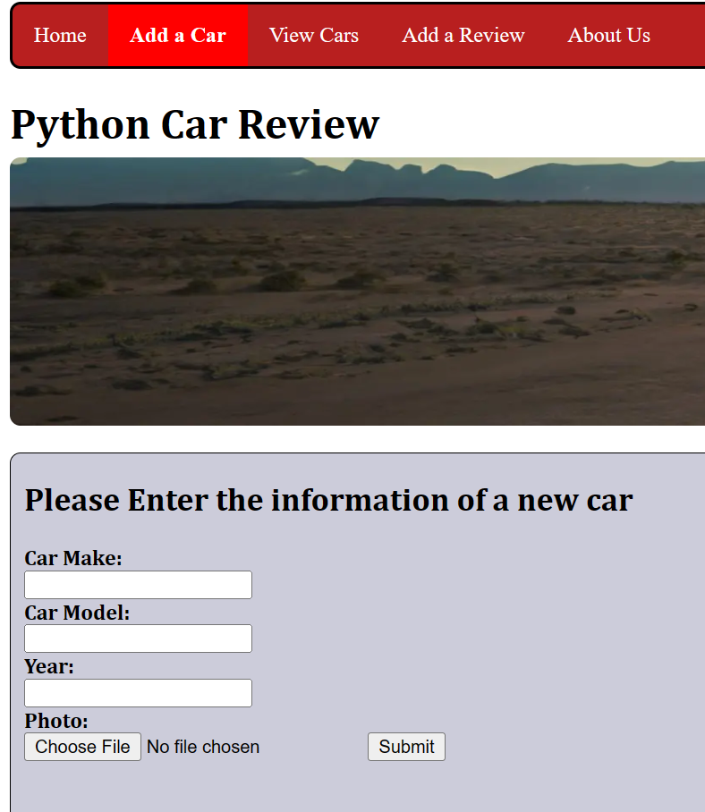
Feature #2: Add System
User can add a new vehicle to the Database
New vehicle will be visible and can be used for reviews from all users
User can specify
Car Make
Car Model
Year
Photo (user uploads photo of vehicle)

Slide 11
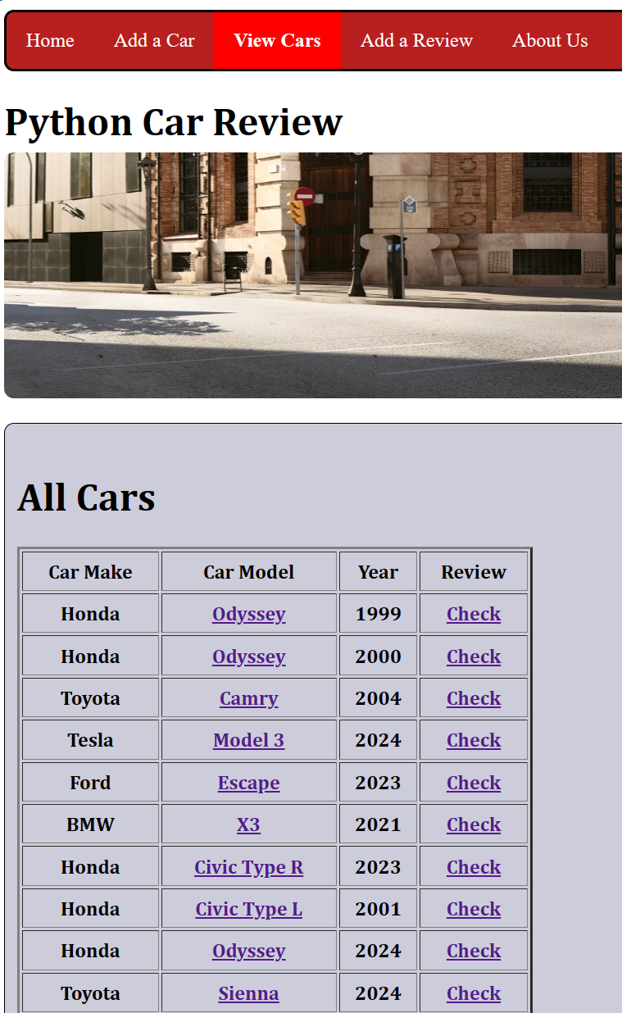
Feature #3: Browse System
Browse system displays library of vehicles saved in the database
Users may click on model to display that vehicle
Users may click on review to display the reviews associated with that vehicle

Slide 12
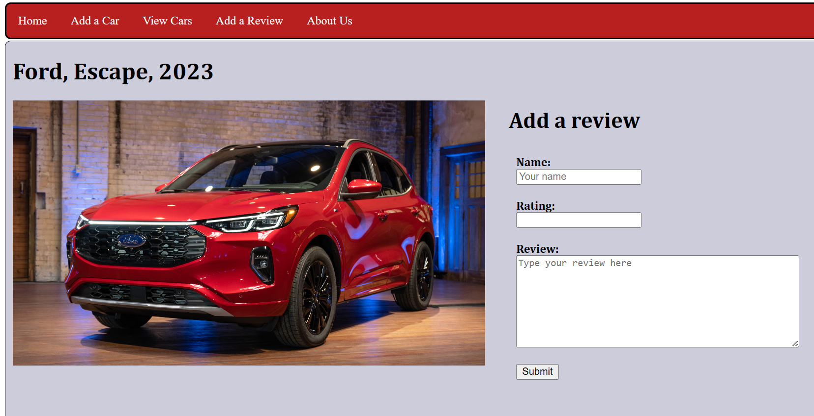
Feature #3: Displays Car
User will be redirected to a webpage specific for that vehicle
Displays the make, model and year of the vehicle
Displays the photo of the vehicle
Adds the option for users to leave their own review for the vehicle

Slide 13
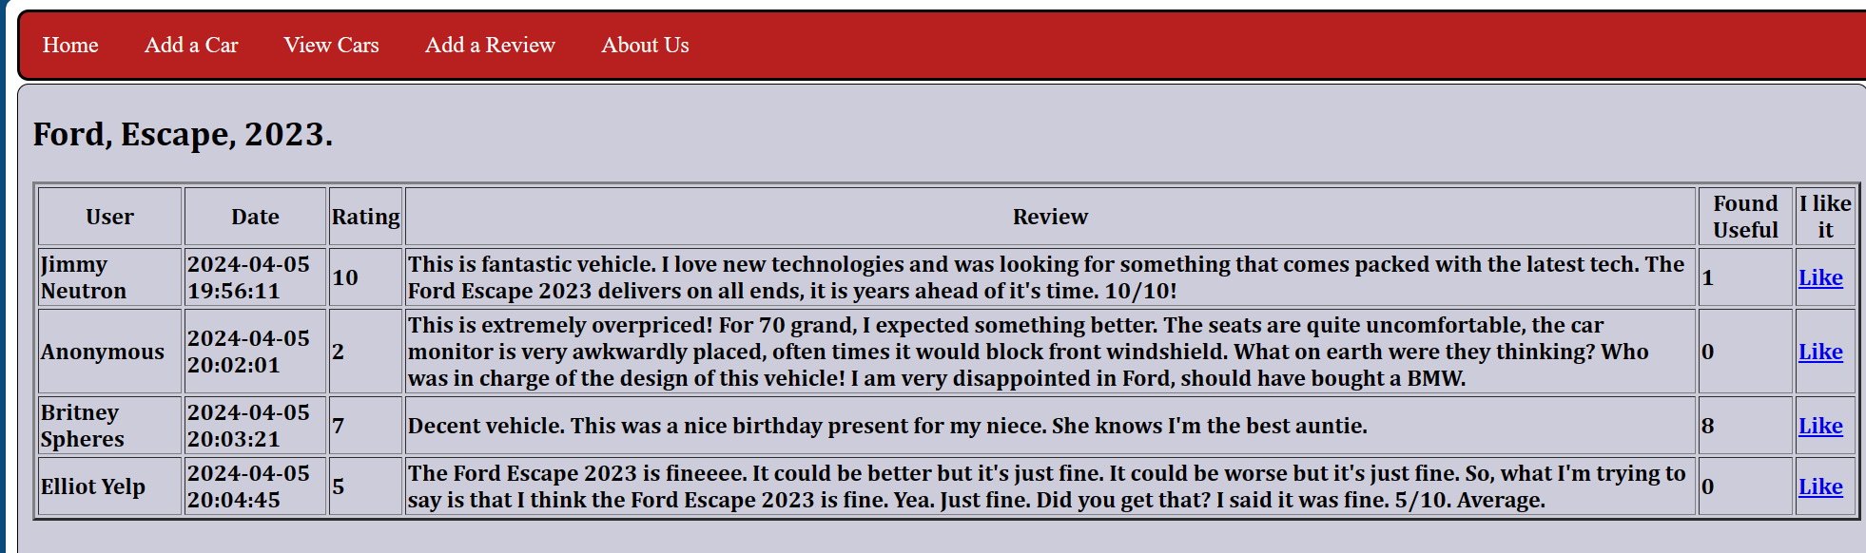
Feature #3: Displays reviews
User will be redirected to a webpage specific for that vehicle
Displays all reviews made for that vehicle

Slide 14
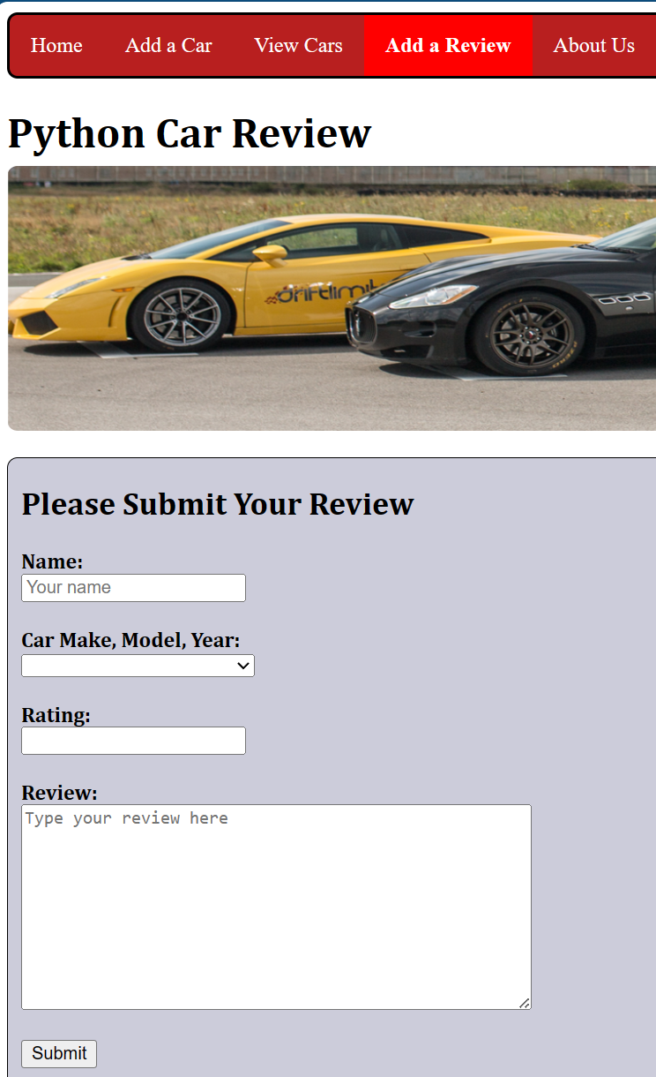
Feature #4: Add Review
The Add a Review page lets the user choose their vehicle and the option for them to submit their review for that vehicle
User must specify
Car Make
Car Model
Year of Manufacture
Rating of 1 to 10 (out of 10)
Review

Slide 15
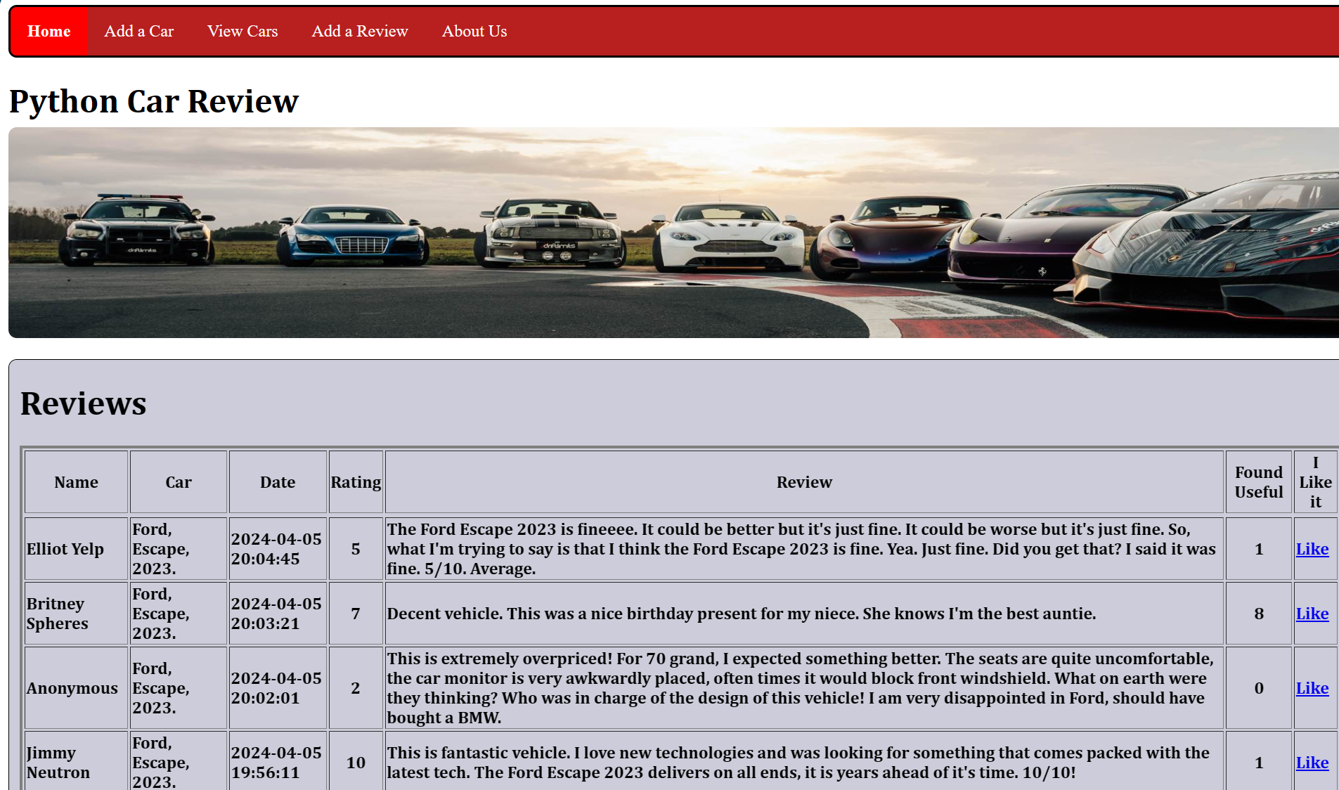
Feature #5: Rating and Like system
The home page lists the most recent reviews from latest to oldest
User can see the ratings left by other users
User can like other reviews, give others the general perception of that review

Slide 16
Objectives + Outcomes

Slide 17
Thank You
SRT 211 Final Project
Group 6
Student Names: Yau On Li, David Tang
Student ID: , dtang31

